Slide 1
VR2021: Assignment 1
Image analysis and rule based methods
10 marks
Deadline: Feb 7, 2021
Initial 2-page progress report(not graded): Jan 31, 2021

Slide 2
Before you start
Original and extra efforts will be appreciated
Do not copy code or report || Do not share your code or report
If you do so, -10 marks (both source and destination)
Expect a call anytime for questions about your assignment

Slide 3
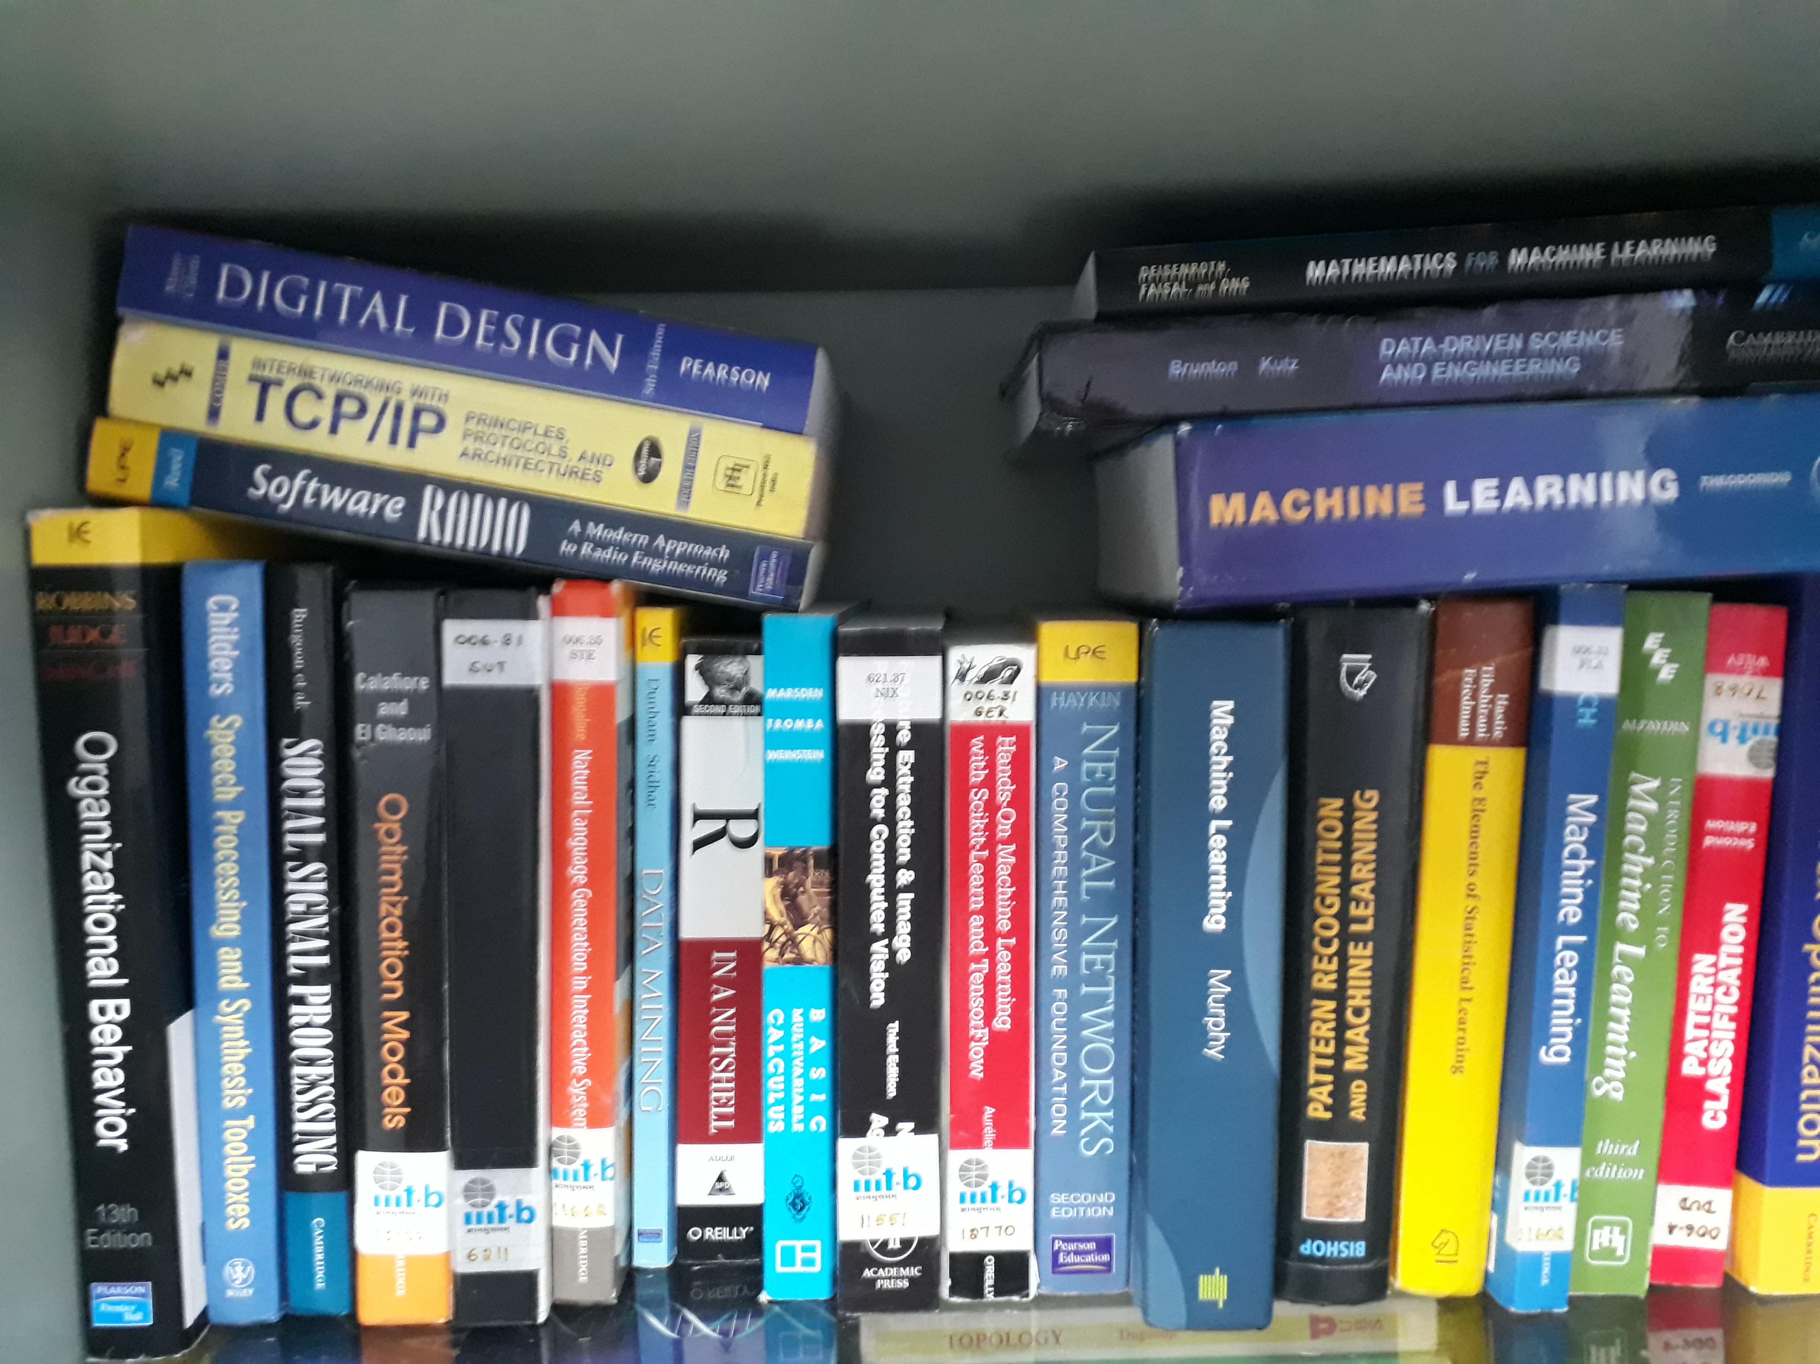
Book counting
Write a rule based algorithm to
count the number of books in
my shelf
Check if it generalizes on your shelf/other instances
Document your observations
Your hypothesis and attempts are more
Important than accurate results

Slide 4
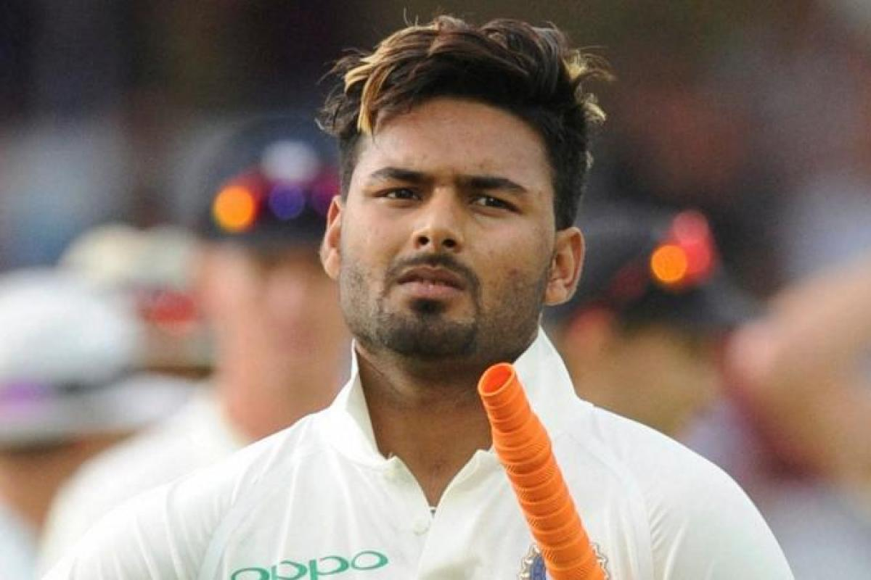
Pixels on your face
Take a selfie of yourself
Write an algorithm to mark out pixels of your face
See if this works well on your friends (one boy and one girl)
Try on this image as well.
Do several experiments and write your observations.
Your hypothesis and attempts are more important than accurate results

